Slide 1

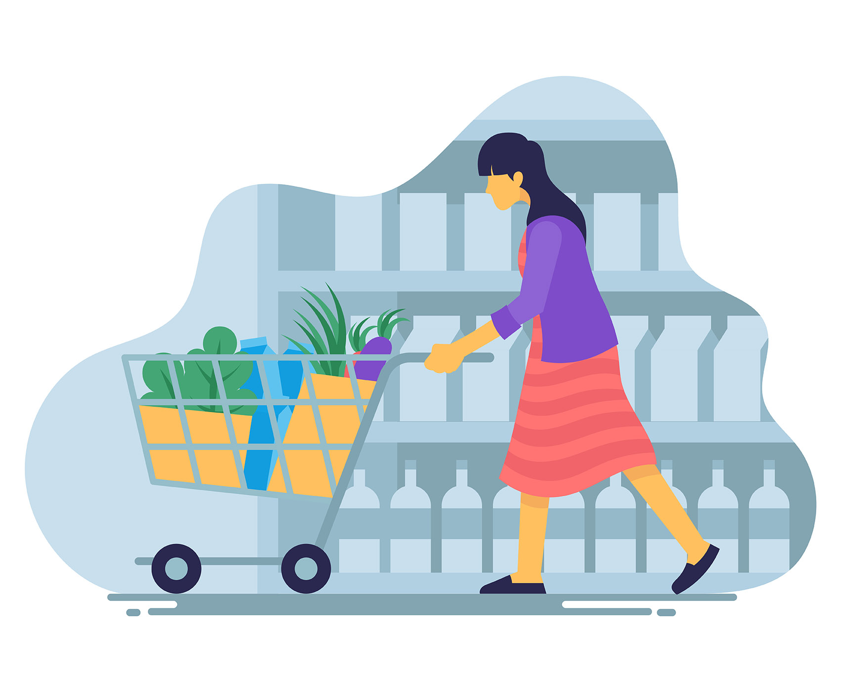
TEXT MINING & MARKET BASKET ANALYSIS FOR GROCERY STORES
VANDANA ANAND
SOUMYA JOSHI

Slide 2
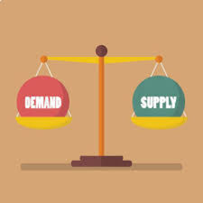
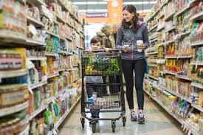
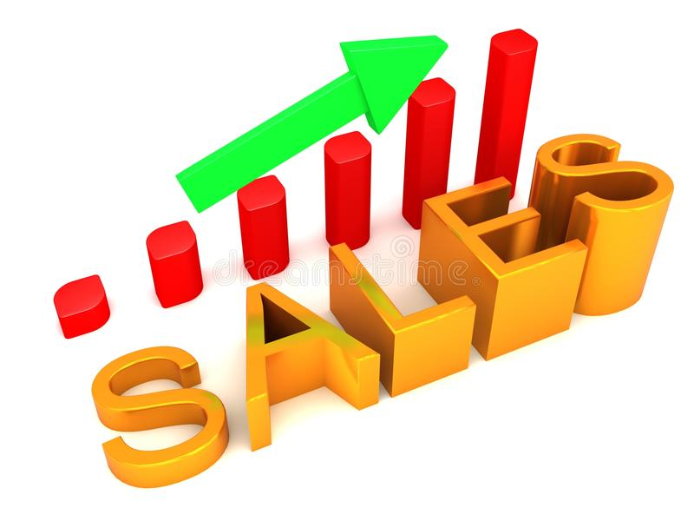
Background
Grocery stores and its products serve as essential needs for customers
The main goals of retail businesses, especially grocery stores, are to:
increase sales
maintain a smooth balance between supply and demand
A retailer must make the effort to present all applicable options to increase customer engagement and have appropriate price points
Notes:
Grocery stores and products sold are essential items that customers will buy almost everyday. It is an important business that carry necessities
Retail businesses, and especially grocery stores, have the goal to increase sales and maintain a smooth balance between supply and demand. In order to be on top of their game, these businesses have to come up with options to increase customer engagement and subsequently have appropriate price points.

Slide 3
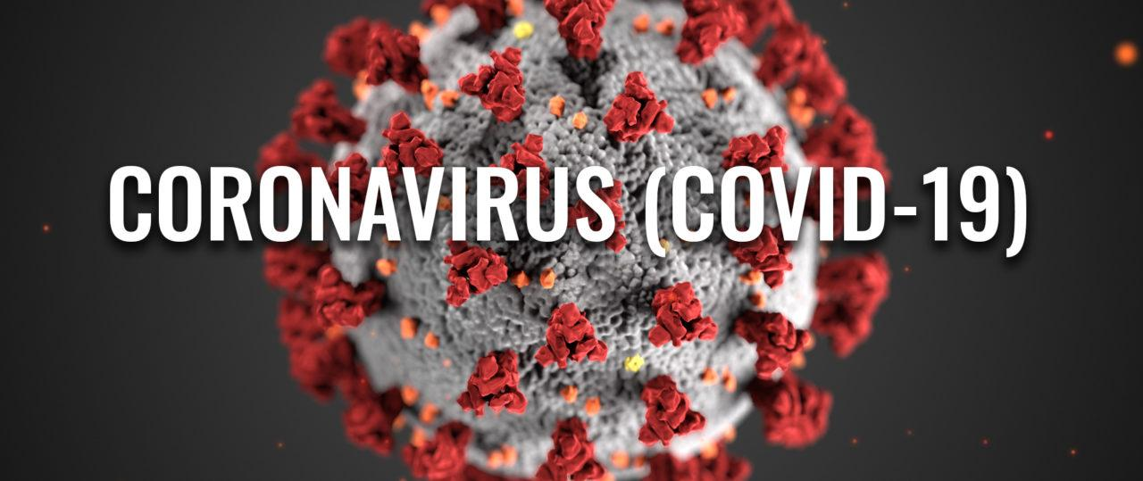
Impact of COVID-19
Amid the COVID 19 pandemic, grocery stores are seeing a sharp rise in demand that are unprecedented for many products, causing a decline in supply
If items purchased together are not known, we may run out of stock of products for long periods of time.
COVID 19 has also changed the types of products which are bought together, therefore, analyzing these transactions is extremely important at this time for grocery stores to remain successful and competitive
Notes:
For example, toilet paper and disinfecting products have long run out of stocks as their demand was completely unprecedented. Some common household and pantry items are also running out of stock as the demand and supply could not go hand in hand.

Slide 4
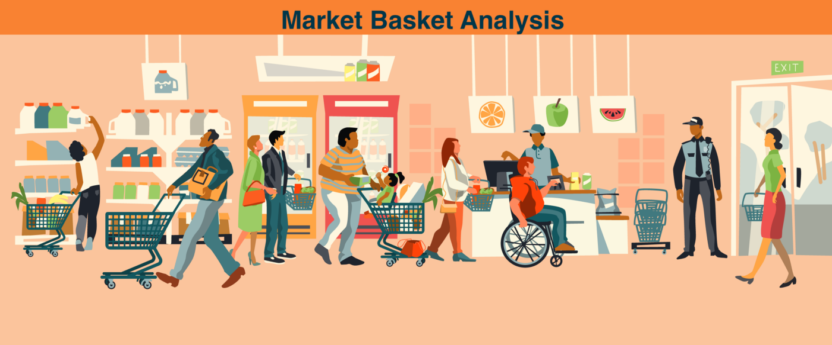
Market Basket Analysis
One approach to find customer buying patterns is the Market Basket Analysis.
It is a key technique used by large retailers like Amazon, Flipkart, etc to analyze customer buying habits by finding associations between the different items that customers place in their “shopping baskets”.
Notes:
One solution to combat the issue of supply and demand as well as increasing sales are to find customer buying patterns using the Market Basket Analysis. The MBA is a modelling technique based upon the theory that if you buy a certain group of items, you are more (or less) likely to buy another group of items.
The set of items a customer buys is referred to as an itemset, and this technique seeks to find relationships between these purchases.
A key technique that large retailers such as Amazon and Flipkart use are to analyze customer buying habits by finding associations between different items that customers tend to buy

Slide 5
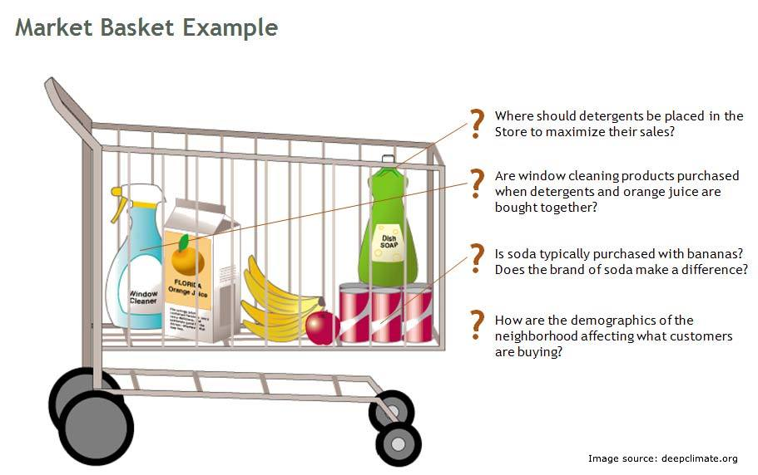
Market Basket Example: Questions to Answer
Notes:
The questions that the market basket analysis seek to investigate are, for example:
Where should detergents be placed in the store to maximize their sales?
Are certain products bought along with juice and soap?
Is soda usually bought with bananas? Is there a specific brand of soda that makes a difference?
How are the demographics of the neighborhood affecting which customers buy which items or itemsets?
These questions can lead to interesting revelations for the business that can potentially change their outlook

Slide 6
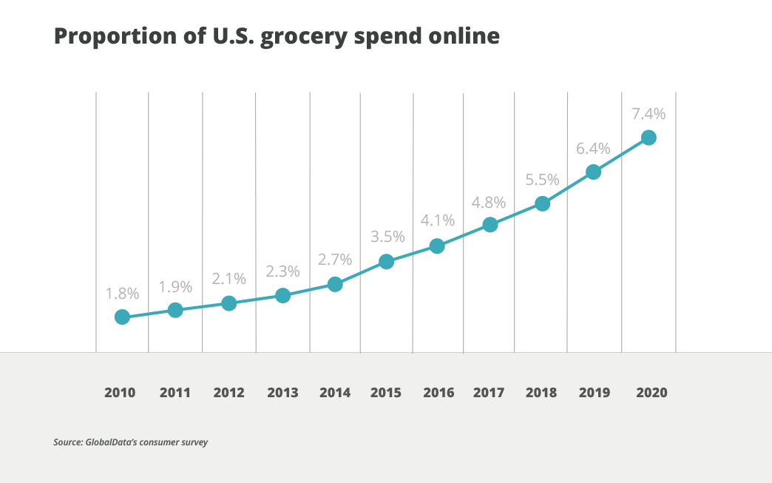
Business Application
US online grocery store spending increases every year, which especially spiked in 2020 during the pandemic
The discovery of associations between products can help retailers develop marketing strategies as well as determine frequently bought items and product placements in stores to appeal to customers since they are in a rush to get in and out of the store for safety during the coronavirus outbreak
Notes:
The US online grocery spending increases every year, and especially spiked in 2020 during the pandemic as shown in the graph.
The discovery of associations between products can help retailers develop marketing strategies as well as determine frequently bought items and product placements in stores. These improvements can highly appeal to customers since they are already in a rush to get in and out of the store for safety reasons during the coronavirus outbreak
It can also help with the goals to increase sales as well as smooth the balance between supply and demand, which again is a major concern during a pandemic

Slide 7
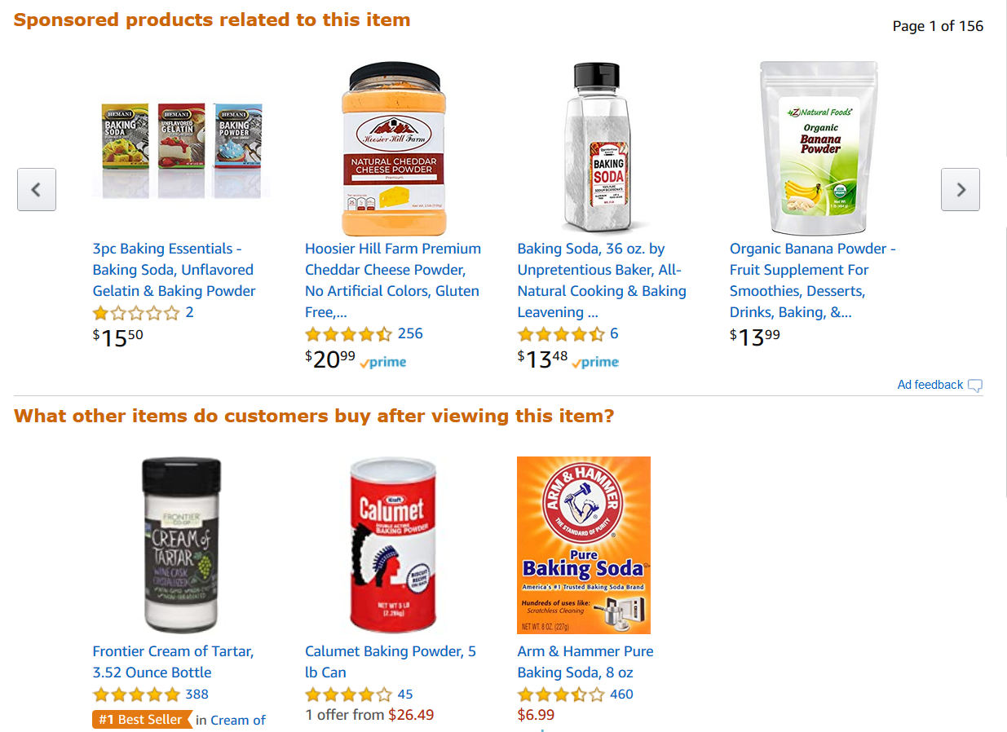
Notes:
The market basket analysis has proven to be especially successful in ecommerce because:
It is much easier to apply recommendation algorithms for online businesses
Customers can linger for more time online so they are more likely to browse similar products
Not only can the modelling technique be applied to grocery stores, but it has many other business applications as well such as clothing, shoes, and other retail businesses.

Slide 8

Dataset
The dataset used in the project is called “Market Basket Optimization” from Kaggle
The dataset contains items from each of 7500 transactions bought by various customers in a grocery store.
Notes:
The dataset that we used in order to investigate the problem at hand is called Market Basket Optimization from Kaggle.
For example, each row in the dataset represents a transaction. In a transaction, a customer could have bought eggs, cheese, milk, vegetables etc.

Slide 9

Text Mining for Customer Behaviour
Customer purchase behaviour can be used to find the most popular items in a grocery store.
Performed text mining techniques on customer purchase behaviour using Rapidminer to find the top trending items bought in the grocery stores.
Notes:
Customer behavior purchases and trending, most popular items can be found out by looking at customer

Slide 10
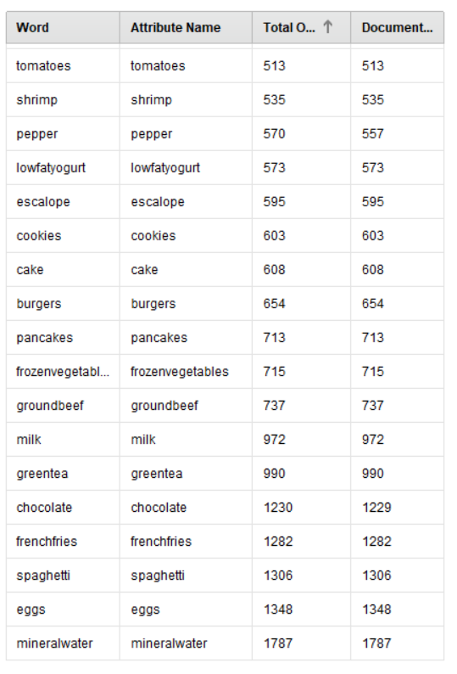
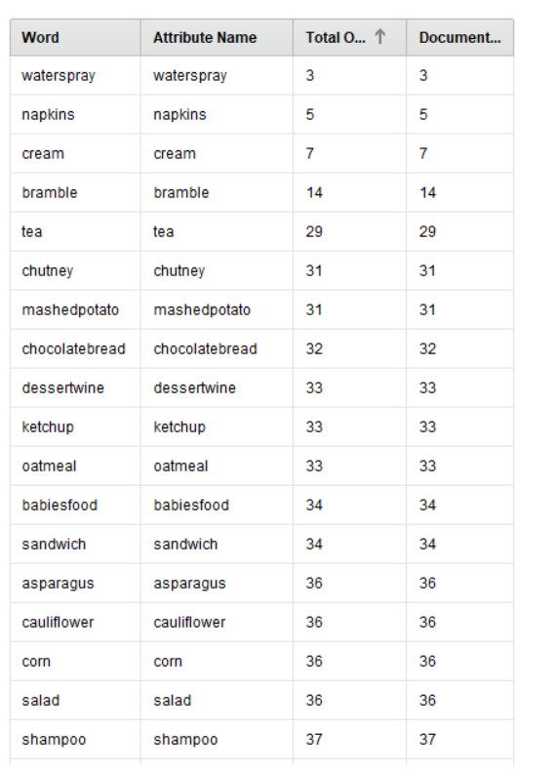
Text Mining Results
Most popular items in the grocery store
Least popular items in the grocery store
Notes:
We decided to do data mining for customer purchases and figure out which product has been the most popular among customers, of course seasons, trends and pandemic can frequently change this result.

Slide 11
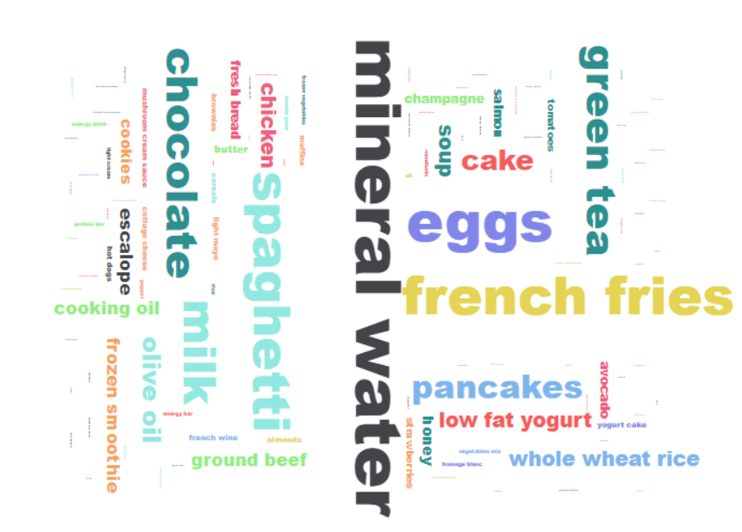
Data Visualization for the Text Mining Results
Notes:
Mineral water is the most bought item followed by eggs, french fries pancakes etc. Now after finding out the most popular item, we need to find which items are frequently brought together. For this we need to apply market basket analysis using apropri algorithm.

Slide 12
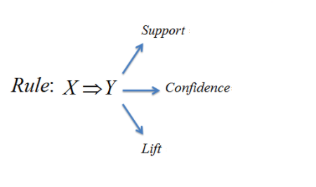
Market Basket Analysis using the Apriori Algorithm
An indication of how frequent the item set appears in the dataset
An indication of how often the rule has been found to be true
Greater lift values (>1) indicate stronger associations between X and Y and they depend on one another
Notes:
Apriori algorithm is used to find the frequent itemsets. It has three major components:
Support is the popularity(frequency of occurrence) of an item (validity of item)
Confidence is likelihood of occurrence of item B if item A occurs(Conditional Probability).
Lift ratio is the increase in the ratio of occurence of item B if item A occurs. ()lift is a measure of the efficiency performance of a targeting model (association rule)
Gretaer than 1

Slide 13
Association Rules for the Dataset
Association rules | Support | Confidence | Lift Ratio
{bottled water} => {whole milk} | 0.034367056 | 0.310947562 | 2.004778909
{cream cheese,yogurt} => {whole milk} | 0.012404677 | 0.532786885 | 1.513634095
{frozen vegetables,other vegetables} => {root vegetables} | 0.006100661 | 0.44 | 3.0474349
{brown bread,whole milk} => {yogurt} | 0.007117438 | 0.322241681 | 2.023329493
{sliced cheese} => {sausage} | 0.00701576 | 0.342857143 | 3.145522388
Notes:
There are more than 400 association rules that can be formed with our dataset, however, most of them are trivial and further analysis is required. This is just the few of the relevant association rules on basis of support, confidence and lift ratio.

Slide 14
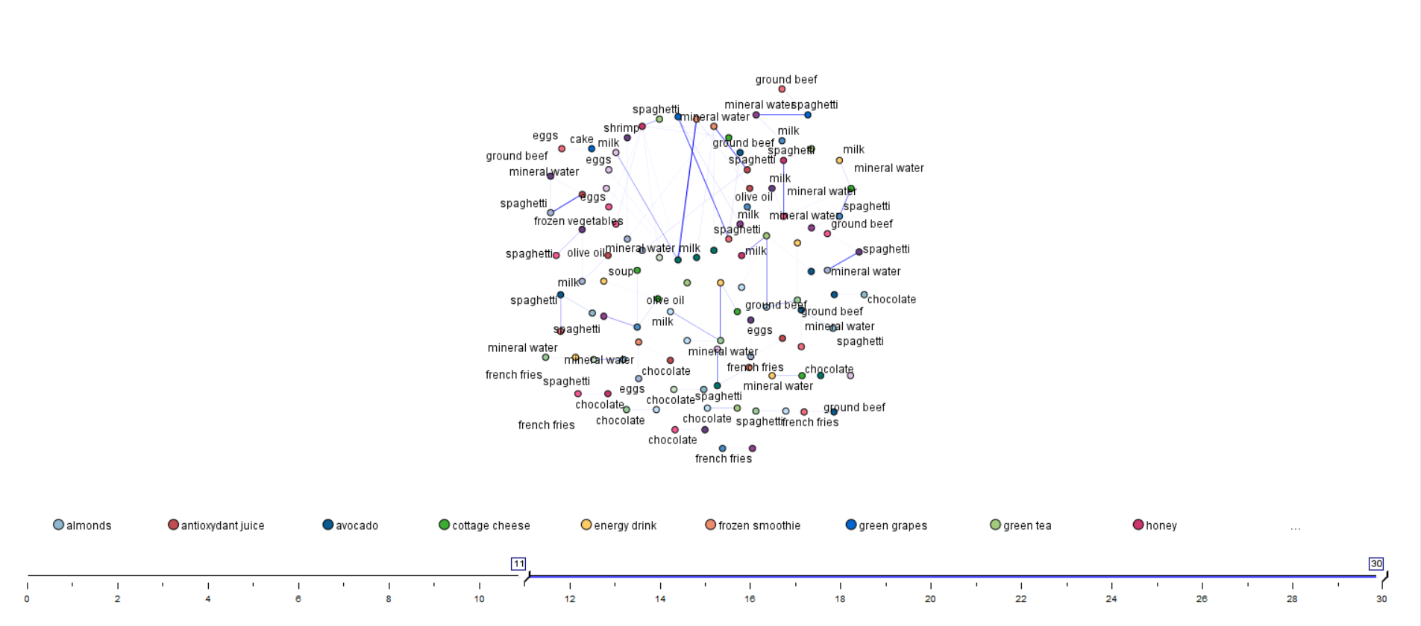
Visualisation of Association Rules
Notes:
So this is a web visualisation of the dataset where we can see which items are clearly connected so as to show the frequent itemsets.
Mineral water and milk, water and spaghetti, and vegetables and eggs are frequent pairings

Slide 15

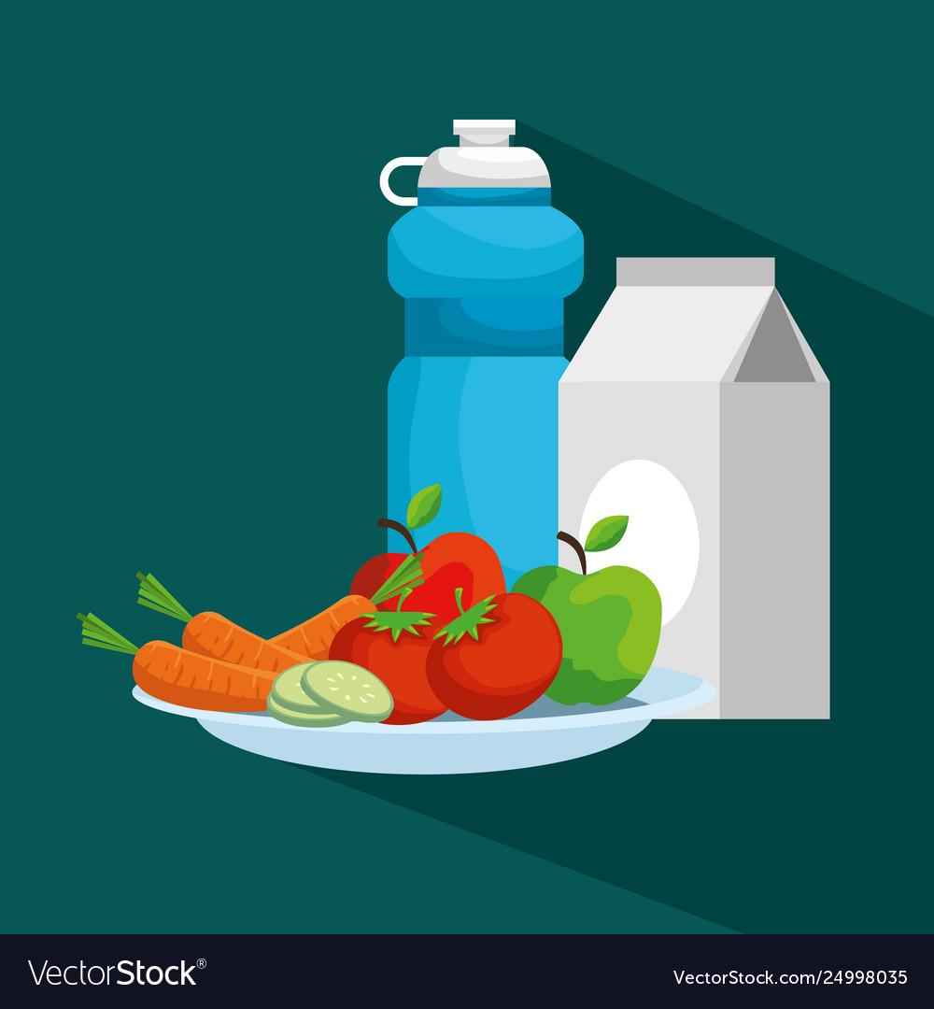

Inference from the Analysis
The top rules are dominated by “whole milk”, “bottled water” and “other vegetables”, which are few of the most frequently bought items overall.
Considering the support, confidence and lift ratio we can understand the frequently bought item sets such as dairy items, cheese and sausage.

Slide 16
Conclusion and Recommendations
In retailing, most purchases are bought on impulse. Market basket analysis gives clues as to what a customer might have bought if the idea had occurred to them.
As a first step, therefore, market basket analysis can be used in deciding the location and promotion of goods inside a store. For example, essentials items like water and medicine can be placed at the front.
Second it can be used to purchase similar amount of stocks of items which are frequently brought together so that the sales are not affected due to limited stock.
Notes:
Increase impulse purchases by giving customer clues , where to places items in the grocery store to increase their purchase, and obviously to kee

Slide 17

FUTURE SCOPE
Market Basket Analysis is the first level of analysis. Differential market basket analysis can find interesting results and can also eliminate the problem of a potentially high volume of trivial results.
Grocery stores, including small businesses can implement this strategy in order to keep a balance between supply and demand as well as remain in business
Notes:
In our case we have got around 400 association rules, lot of which are trivial and circumstantial, hence differential market basket analysis can eliminate them.

Slide 18
REFERENCES
https://blogs.oracle.com/datascience/overview-of-traditional-machine-learning-techniques
https://www.foodnavigator-usa.com/Article/2019/07/19/FMI-US-grocery-shoppers-frequent-more-stores-per-month
https://www.vectorstock.com/royalty-free-vector/demand-and-supply-ball-balance-on-the-scale-vector-13616387
https://www.dreamstime.com/illustration/increasing-sales-graph.html
https://towardsdatascience.com/increasing-kaggle-revenue-analyzing-user-data-to-recommend-the-best-new-product-f93fddbb4e0f
https://www.furman.edu/covid-19/
https://pixabay.com/illustrations/text-mining-icon-data-mining-icon-2793702/
https://www.vectorstock.com/royalty-free-vector/water-bottle-with-milk-box-and-fruits-with-vector-24998035
https://www.istockphoto.com/illustrations/cheese?mediatype=illustration&phrase=cheese&sort=mostpopular
https://pixabay.com/vectors/sausage-links-food-meat-beef-33013/
https://www.pngfind.com/mpng/hiJiwwT_future-icon-future-work-icon-png-transparent-png/

Slide 19
Thank you!

